Slide 1
Lemonade Roadmap Proposal
Team 2 Security Consultants : Sharon, Sri, Abayomi, Eden

Slide 2
Introduction
Our solutions for Lemonade Online Insurance company
Post-Audit Recommendations: Actionable insights to enhance your security posture.
Comprehensive Security Solutions: Tailored strategies to secure your company against evolving threats.
Cost-Effective Approach: Optimizing resources for maximum protection and compliance.
Continuous Improvement: Ongoing support and updates to maintain robust defenses.
Team2 Security Group
A leading cybersecurity consultancy specializing in developing tailored, cost effective robust security solutions for digital-first companies.
Proven Success Trusted by tech-driven clients for data protection and compliance.
Client-Focused Security strategies aligned with each client’s unique needs.
Innovation-Driven Proactive, cutting-edge methods to stay ahead of threats.

Slide 3
Objectives
Protect Critical Assets
Ensure Business Continuity
Safeguard data, IP, and IT systems.
Use antivirus, firewalls, IDS/IPS, SIEM, and regular patches.
Maintain secure operations with robust defenses.
Regularly update and configure systems.
Ensure Regulatory Compliance
Enhance Customer Trust
Establish GRC team for audits and compliance.
Share security updates in reports and newsletters.
Promote privacy measures like MFA and customer education.
Notes:
We’ve identified that Protecting critical assets. Ensuring business continuity, Complying with industry regulations, Enhancing customer trust are your biggest concerns when it comes to Lemonade’s security posture. The following milestones will address each of these pain points.

Slide 4
Milestones & Timeline
Quarterly benchmarks
Jan ·
Gap Analysis
Jun ·
SOC Expansion
Dec. ·
Maintenance
Identify vulnerabilities, risks, and develop a prioritized roadmap
Recruit, onboard, and integrate specialist, defining team role scope.
Ongoing improvement;
Continuous monitoring.
Feb
Apr
Jun
Aug
Oct
Dec
Jan
Mar
May
Jul
Sep
Nov
Apr ·
Enhancements
Sep ·
Cyber+
cybersecurity awareness training, certify key personnel.
Configure advanced security solutions, conduct regular security and penetration testing.
Notes:
Phase 1, Gap Analysis,January to March; Identify vulnerabilities, risks, and develop a prioritized roadmap.
Phase 2: Level up your team,April to June; cybersecurity awareness training, implement ongoing security training programs, and certify key personnel.
Phase 3: We hire contractor,July to September;Recruit, onboard, and integrate specialist, defining team role scope.
Phase 4: Implement advanced cyber systems,October to December; deploy,configure advanced security solutions, conduct regular security and penetration testing.
Phase 5: Ongoing improvement;Continuous monitoring.

Slide 5
Resource Allocation:
Current Technical Support team will be trained to demonstrate NIST recommended security measures in their work
Sunset legacy software
Full migration to Amazon Web Services
  harden firewall, segment your network and implement role based access control
Notes:
Current Technical Support team will be trained to demonstrate NIST recommended security measures in their work

Slide 6
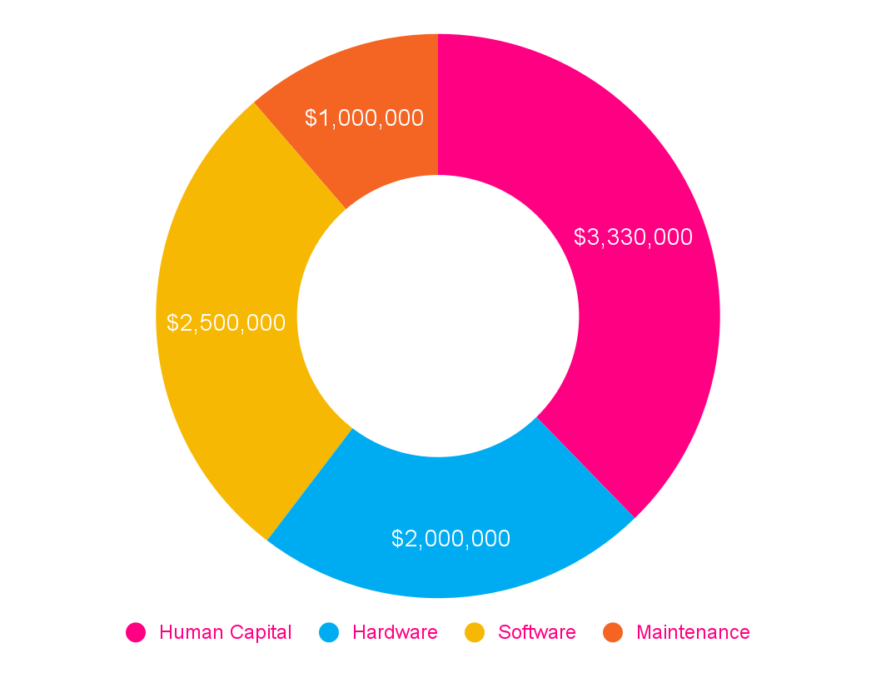
High-level Budget Estimation
• Skilled security team and leadership
• Roles for analysis, response, and training
Human c.
• Firewalls, IDS/IPS, SIEM, and EDR
• Essential for network and endpoint defense
Hardware
Software
• Protection, detection, and compliance tools
• Includes endpoint, cloud, and threat intelligence
• Staff training and system upkeep
• Regular updates and support services
Maint.

Slide 7
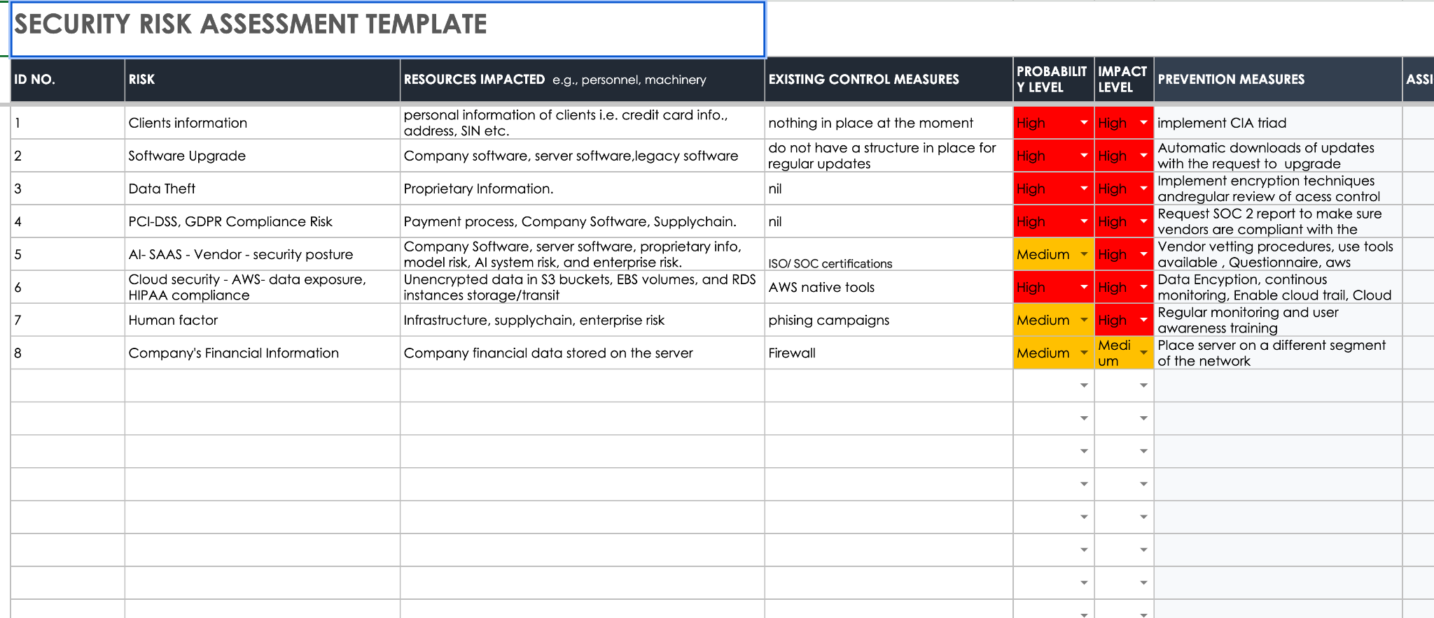
Risk Assessment

Slide 8
Challenges
GRC International Laws
Impact: Non-compliance risks heavy fines and legal challenges globally, impacting reputation and operations.
Mitigation: Establish a dedicated GRC team to monitor and adapt to regulatory changes across all markets.
Constantly Emerging Cyber threats
Impact: Constant threats can overwhelm defenses, leading to potential data breaches and financial loss.
Mitigation: Implement a proactive threat intelligence platform and update systems frequently to respond to evolving threats.
Human Error at your Enterprise
Impact: Employee errors increase vulnerability, risking data exposure and security breaches.
Mitigation: Regular security awareness training and clear protocols can reduce human error risks across the workforce.

Slide 9
Why Hire Team2
We anticipate challenges, and quickly will pivot our strategy accordingly
∞ Constant communication will remain established. We will be sure to meaningfully respond to stakeholder feedback
Our roadmap aligns perfectly with Lemonade’s stakeholder expectations and pain points
Notes:
Security implementation takes a bit longer than expected i.e. employees do not want to follow proper procedures. Therefore, we need to train employees so that they better understand the importance of protecting information.
While working on each phase the team updates the stakeholder of regular progress. Provide stakeholders with access to Kanban board, so that they can provide regular inputs, so that we can adopt and modify changes as needed.

Slide 10
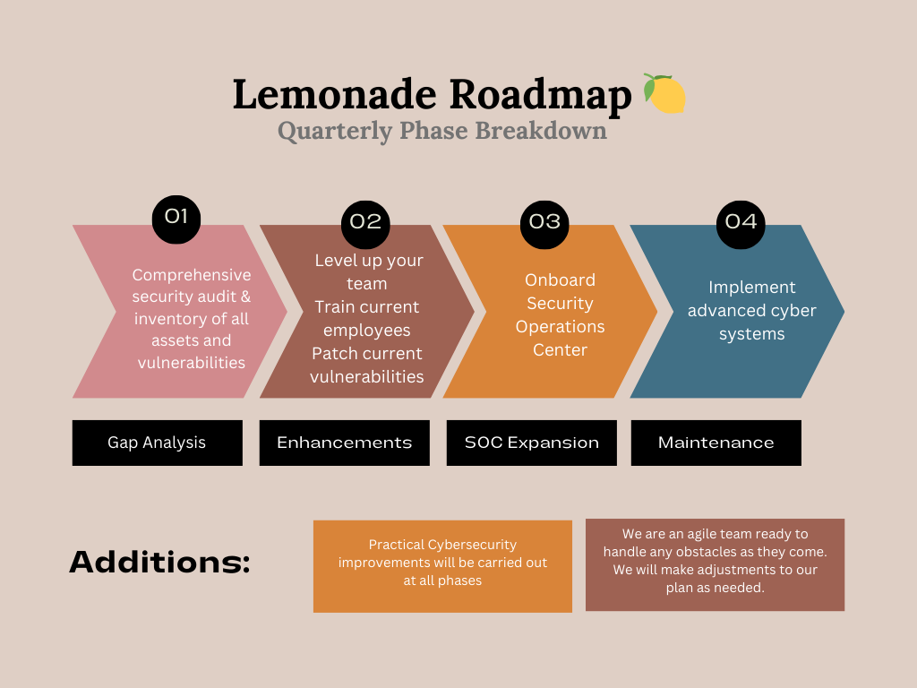
Milestones & Timeline
Each phase = 3 months. Quarterly benchmarks
Phase 1, Gap Analysis,January to March; Identify vulnerabilities, risks, and develop a prioritized roadmap.
Phase 2: Level up your team,April to June; cybersecurity awareness training, implement ongoing security training programs, and certify key personnel.
Phase 3: We hire contractor,July to September;Recruit, onboard, and integrate specialist, defining team role scope.
Phase 4: Implement advanced cyber systems,October to December; deploy,configure advanced security solutions, conduct regular security and penetration testing.
Phase 5: Ongoing improvement;Continuous monitoring.
Notes:
Phase 1, Gap Analysis,January to March; Identify vulnerabilities, risks, and develop a prioritized roadmap.
Phase 2: Level up your team,April to June; cybersecurity awareness training, implement ongoing security training programs, and certify key personnel.
Phase 3: We hire contractor,July to September;Recruit, onboard, and integrate specialist, defining team role scope.
Phase 4: Implement advanced cyber systems,October to December; deploy,configure advanced security solutions, conduct regular security and penetration testing.
Phase 5: Ongoing improvement;Continuous monitoring.

Slide 11
Objectives
Protect Critical Assets
  Safeguard data, IP, and IT systems.
  Use antivirus, firewalls, IDS/IPS, SIEM, and regular patches.
Ensure Business Continuity
  Maintain secure operations with robust defenses.
  Regularly update and configure systems.
Ensure Regulatory Compliance
  Establish GRC team for audits and compliance.
Enhance Customer Trust
  Share security updates in reports and newsletters.
  Promote privacy measures like MFA and customer education.
Notes:
We’ve identified that Protecting critical assets. Ensuring business continuity, Complying with industry regulations, Enhancing customer trust are your biggest concerns when it comes to Lemonade’s security posture. The following milestones will address each of these pain points.

Slide 12
Challenges
Delay in ordering hardware and software
Insufficient Licenses for software
Overlooked patches to software
Phase 2 depends on Phase 1. If work becomes blocked during that phase, the timeline may be longer than originally planned.

